Slide 1
Investigation of in vitro wound healing properties of Metformin and Coenzyme Q10
AYŞE SENA ALTUN
Asst. Prof. Eray Metin Güler
Bezmialem Vakif University
June, 2021
This project was funded by TUBITAK (Project no: 1919B012000845)
Notes:
hgedhsgdhsdgshgd

Slide 2
Plan
Research hypothesis
Objectives
Materials and methods
Analysis of Data
Results
Discussion
Conclusion
Future Aims

Slide 3
Wound healing is a set of specific biological processes related to growth and tissue regeneration.
It consists of intertwined stages called hemostasis, inflammation, migration, proliferation and maturation.¹
¹(Percival, 2002)

Slide 4
Q10
Fat-soluble molecule²
Vitamin-like structure
Anti-diabetic drug
Anti-inflammatory and angiogenic effects
Metformin
² (Bentinger, Tekle, & Dallner, 2010; Yoneda et al., 2014)

Slide 5
Research hypothesis
Metformin and Coenzyme Q10 will increase the migration of cells, show anti-inflammatory and antioxidant activity in the wound model created with human dermal fibroblasts and keratinocytes.

Slide 6
Objectives
To show
Wound healing
Anti-inflammatory
Antioxidant activities

Slide 7
MATERIALS and METHODS

Slide 8
Metformin
Coenzyme Q10
Viability test³
(luminometric ATP method)
Cell culture
(incubation of keratinocytes and fibroblasts)
Apoptosis⁴
(fluorescence microscope)
İntracellular ROS⁸
(fluorometric analysis)
DNA damage⁵
(Comet Assay)
İntracelluler calcium⁷
(fluorometric analysis)
Glutathione Level⁶
(luminometric analysis)

Slide 9
Metformin
Coenzyme Q10
Wound model creation with CytoSelect™ 24-Well Wound Healing Assay plate and apparatus
Inflammation Level⁹ (IL1β, IL6, TNFα, VEGF, EGF)
(Photometric method)
Visualization of wound healing at different doses

Slide 10
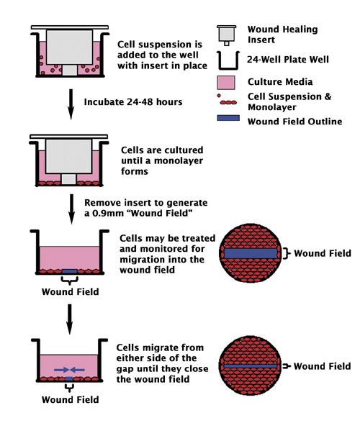
Creation of wound healing model

Slide 11
Analysis of Data
Experiments were repeated 4 times.
Mean ± standard deviation (Mean ± SD)
Analysis of variance (One-way ANOVA)
SPSS version 23

Slide 12
RESULTS

Slide 13
Viability
 | Metformin |  |  | Coenzyme Q10 |  |  | Metformin + Coenzyme Q10
 | HEKa | CCD1079Sk | HEKa+CCD1079Sk | HEKa | CCD1079Sk | HEKa+CCD1079Sk | HEKa | CCD1079Sk | HEKa+CCD1079Sk
Control | 100 ± 0,00 | 100 ± 0,00 | 100 ± 0,00 | 100 ± 0,00 | 100 ± 0,00 | 100 ± 0,00 | 100 ± 0,00 | 100 ± 0,00 | 100 ± 0,00
5µM | 100,85 ± 1,6 | 100,78 ± 8,79 | 101,54 ± 3,29 | 101,19 ± 2,41 | 103,34 ± 3,63 | 108,11 ± 2,95 | 101,97 ± 4,47 | 105,45 ± 11,37 | 110,72 ± 5,14
10µM | 101,78 ± 6,15 | 106,3 ± 3,22 | 107,59 ± 2,16 | 103,47 ± 4,85 | 108,23 ± 2,27 | 111,556 ± 3,17 | 104,77 ± 3,23 | 111,78 ± 4,68 | 113,1 ± 6,21
20µM | 104,76 ± 7,94 | 109,35 ± 5,15 | 111,76 ± 1,86 | 105,7 ± 4,77 | 115,43 ± 4,96 | 121,22 ± 2,71 | 106,05 ± 6,56 | 119,65 ± 6,31 | 128,74 ± 8,83
40µM | 107,87 ± 7,75 | 112,43 ± 5,11 | 117,84 ± 1,79 | 111,941 ± 5,23 | 122,58 ± 4,92 | 130,75 ± 1,7 | 113,33 ± 9,36 | 123,34 ± 6,19 | 139,39 ± 9,21
60µM | 109,11 ± 10,06 | 114,03 ± 5,16 | 121,76 ± 4,15 | 113,25 ± 7,01 | 129,43 ± 5,22 | 138,51 ± 4,11 | 116,36 ± 7,08 | 137,59 ± 8,61 | 143,38 ± 11,32
80µM | 111,18 ± 12,13 | 117,46 ± 5,52 | 126,59 ± 5,71 | 116,59 ± 3,77 | 134,72 ± 5,31 | 143,04 ± 5,66 | 120,06 ± 6,69 | 141,76 ± 10,52 | 153,99 ± 8,18
100µM | 113,43 ± 9,72 | 122,61 ± 5,55 | 132,07 ± 4,16 | 121,85 ± 6,17 | 142,89 ± 5,47 | 157,28 ± 4,52 | 135,47 ± 7,15 | 150,17 ± 9,01 | 171,48 ± 10,74
200µM | 116,62 ± 11,73 | 127,26 ± 5,69 | 137,61 ± 6,01 | 116,21 ± 6,47 | 130,45 ± 5,57 | 135,525 ± 6,11 | 130,45 ± 8,74 | 145,97 ± 10,99 | 158,92 ± 11,14
300µM | 118,84 ± 18,08 | 131,28 ± 5,26 | 141,42 ± 4,55 | 103,29 ± 3,52 | 108,08 ± 4,64 | 116,15± 4,69 | 127,57 ± 9,68 | 139,22 ± 9,12 | 150,75 ± 7,26
400µM | 120,09 ± 14,24 | 139,55 ± 4,7 | 148,14 ± 6,29 | 89,4 ± 8,96 | 91,06 ± 4,13 | 101,99 ± 6,41 | 116,95 ± 10,06 | 123,05 ± 10,33 | 149,84 ± 12,2
500µM | 111,39 ± 7,52 | 121,65 ± 3,79 | 140,5 ± 4,26 | 64,61 ± 10,05 | 71,93 ± 3,89 | 96,62 ± 3,77 | 95,26 ± 11,2 | 108,56 ± 7,35 | 114,76 ± 13,04

Slide 14
Inflammatory biomarkers – Growth factors
IL1β
IL6
TNFα
EGF
VEGF

Slide 15
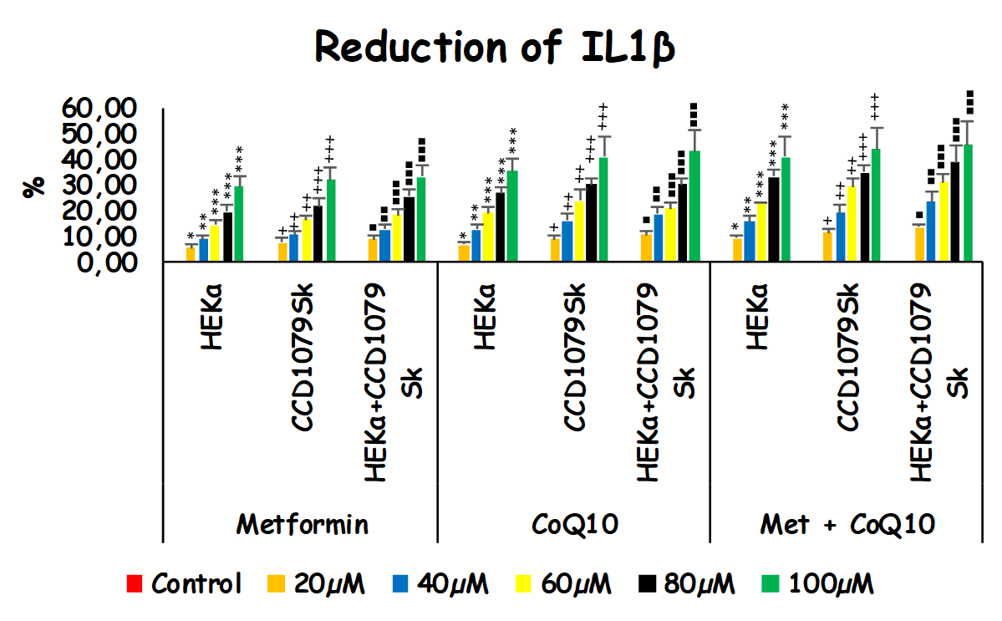
HEKa: Keratinocyctes
CCD1079Sk: Fibroblasts
* p<0,05; **p<0,01, *** p<0,001

Slide 16
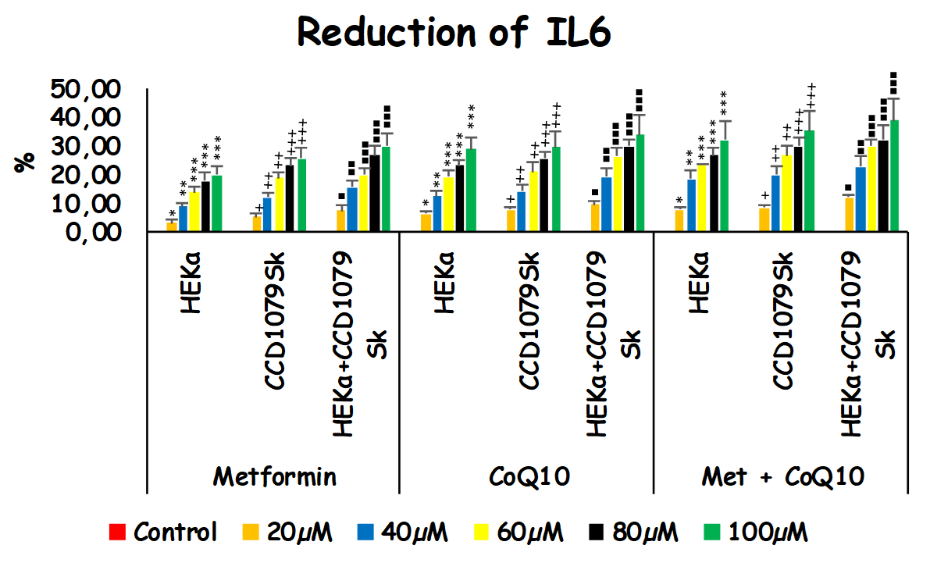
HEKa: Keratinocyctes
CCD1079Sk: Fibroblasts
* p<0,05; **p<0,01, *** p<0,001

Slide 17
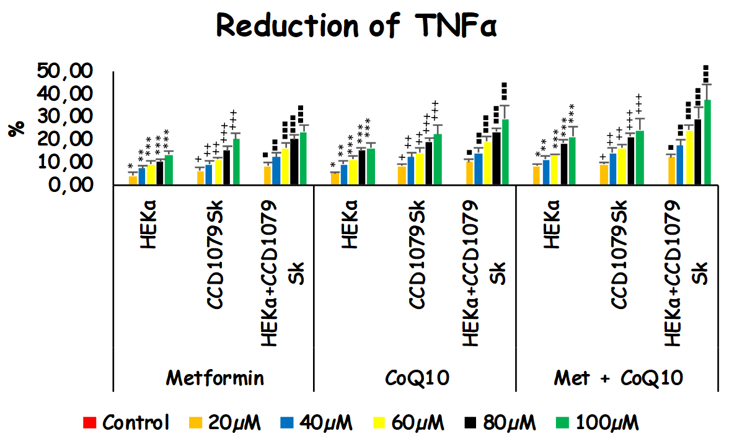
HEKa: Keratinocyctes
CCD1079Sk: Fibroblasts
* p<0,05; **p<0,01, *** p<0,001

Slide 18
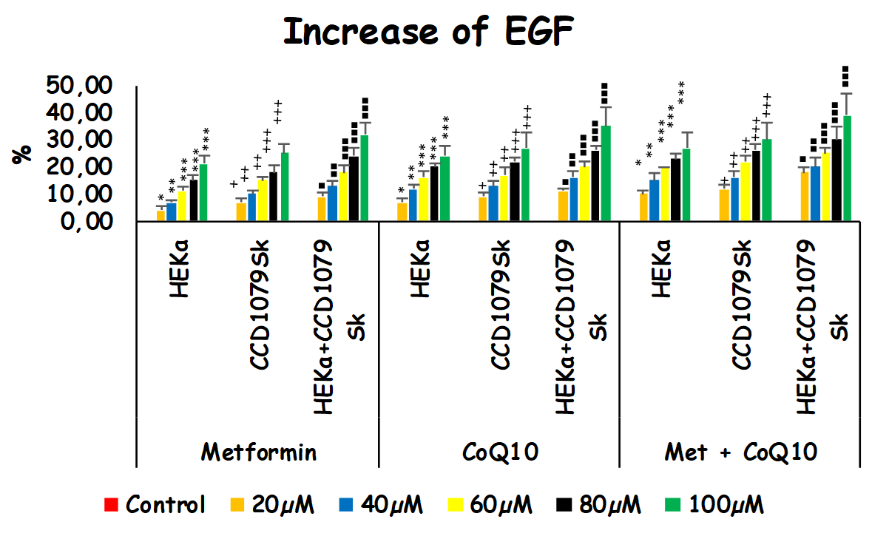
HEKa: Keratinocyctes
CCD1079Sk: Fibroblasts
* p<0,05; **p<0,01, *** p<0,001

Slide 19
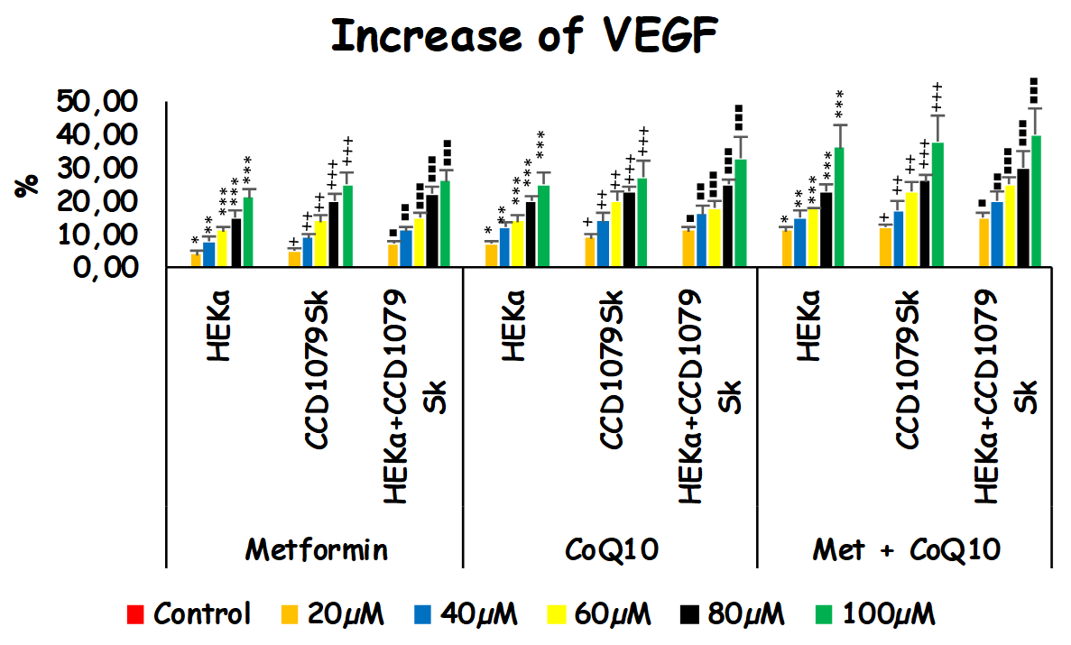
HEKa: Keratinocyctes
CCD1079Sk: Fibroblasts
* p<0,05; **p<0,01, *** p<0,001

Slide 20
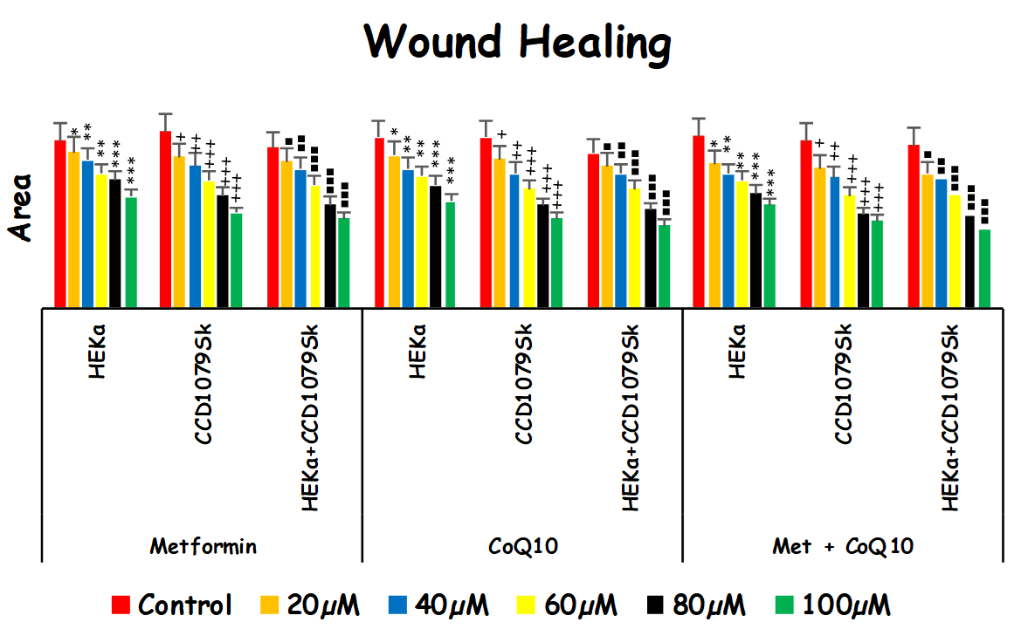
HEKa: Keratinocyctes
CCD1079Sk: Fibroblasts
* p<0,05; **p<0,01, *** p<0,001

Slide 21
Other parameters
Glutathione Level
Apoptosis
Intracellular ROS
Intracelluler calcium

Slide 22
Visualization of wound healing at different doses

Slide 23
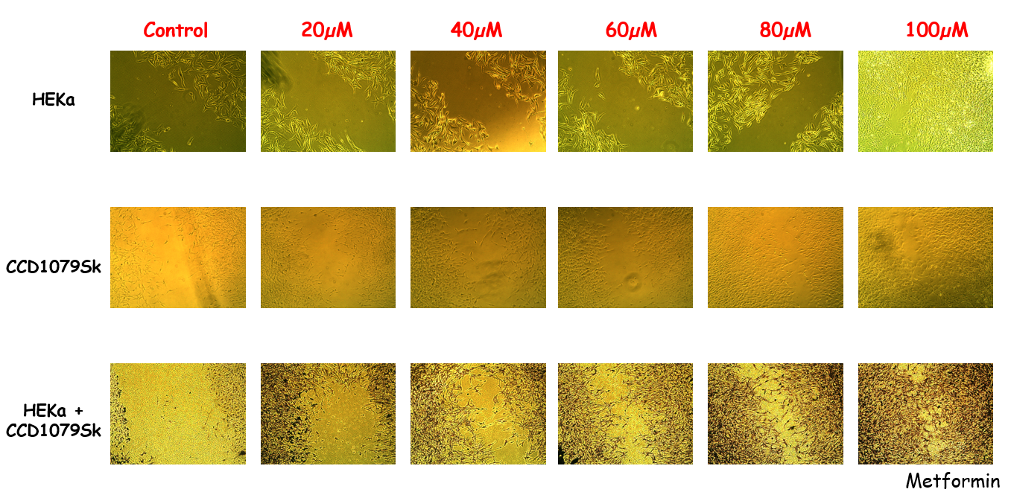

Slide 24
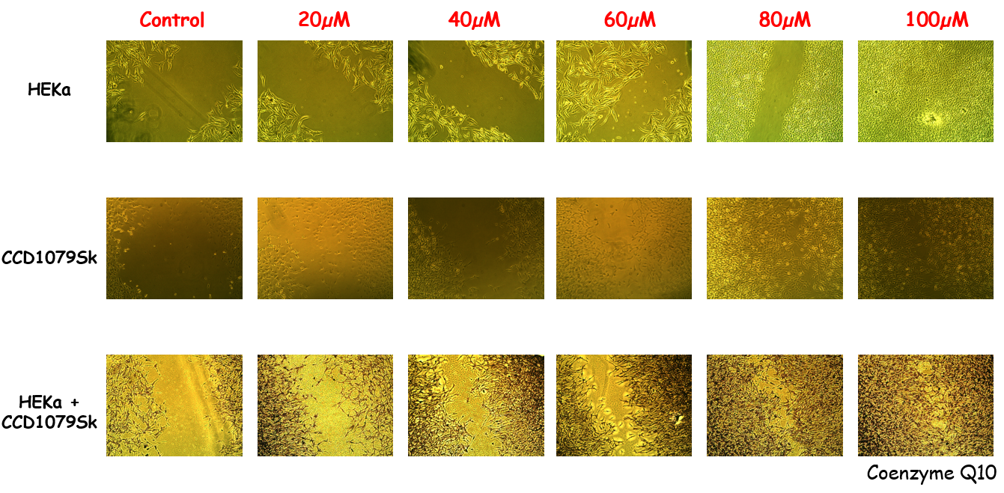

Slide 25
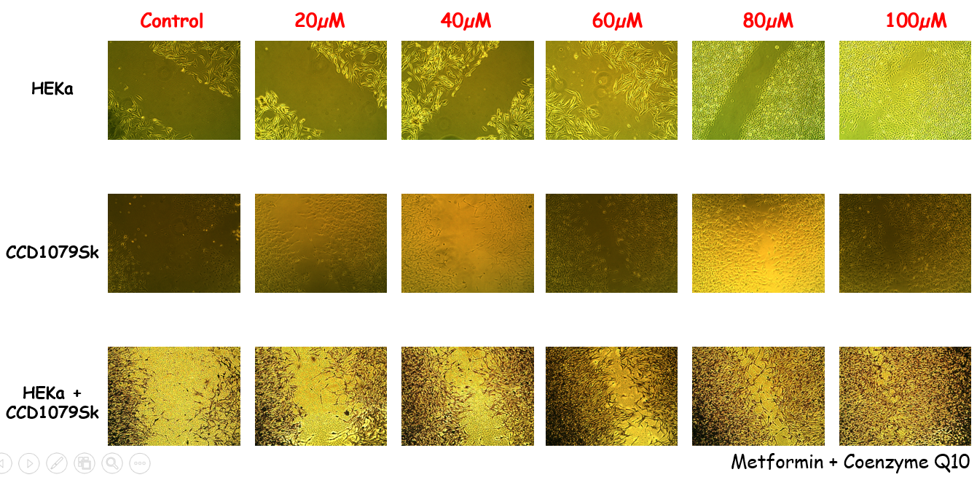

Slide 26
Discussion
Curcumin provided positive effects on wound healing
Some antihypertensive drugs improve wound healing while some of them caused a delay.

Slide 27
Limitations
Strength
In vitro study
Different microenvironment than human skin
First study reporting the effects of Metformin and Coenzyme Q10 on wound model

Slide 28
Conclusion
Increasing single and combined doses of Metformin and CoQ10 were found effective in reducing inflammation and increasing proliferation in in vitro wound model.

Slide 29
Future Aims
Animal experiment ethics committee approval
Further formulations and animal studies should be conducted to obtain better knowledge.

Slide 30
Referances
¹Percival, N. J. (2002). Classification of wounds and their management. Surgery (Oxford), 20(5), 114-117.
²Bentinger, M., Tekle, M., & Dallner, G. (2010). Coenzyme Q–biosynthesis and functions. Biochemical and biophysical research communications, 396(1), 74-79.
^{4,8,9}Kocyigit, A., & Guler, E. M. (2017). Curcumin induce DNA damage and apoptosis through generation of reactive oxygen species and reducing mitochondrial membrane potential in melanoma cancer cells. Cell Mol Biol (Noisy-le-grand), 63(11), 97-105. doi:10.14715/cmb/2017.63.11.17
⁵Singh, N. P. (2016). The comet assay: Reflections on its development, evolution and applications. Mutat Res Rev Mutat Res, 767, 23-30. doi:10.1016/j.mrrev.2015.05.004
⁶ Günes-Bayir, A., Kiziltan, H. S., Kocyigit, A., Güler, E. M., Karataş, E., & Toprak, A. (2017). Effects of natural phenolic compound carvacrol on the human gastric adenocarcinoma (AGS) cells in vitro. Anti-cancer drugs, 28(5), 522-530.
⁷Li, P., Zhao, Q. L., Jawaid, P., Rehman, M. U., Sakurai, H., & Kondo, T. (2016). Enhancement of hyperthermia-induced apoptosis by 5Z-7-oxozeaenol, a TAK1 inhibitor, in A549 cells. Cell Stress Chaperones, 21(5), 873-881. doi:10.1007/s12192-016-0712-6

